Slide 1
MicroWeather Marketplace: Turning Local Weather Data into Shared Value
USE CASE:03
VIGNESH SRIRAM
SAI RAM MAKKAPATI
MALIK ALI HAIDER AWAN
Universität des Saarlandes
SMART FARMING HACKATHON-2025

Slide 2
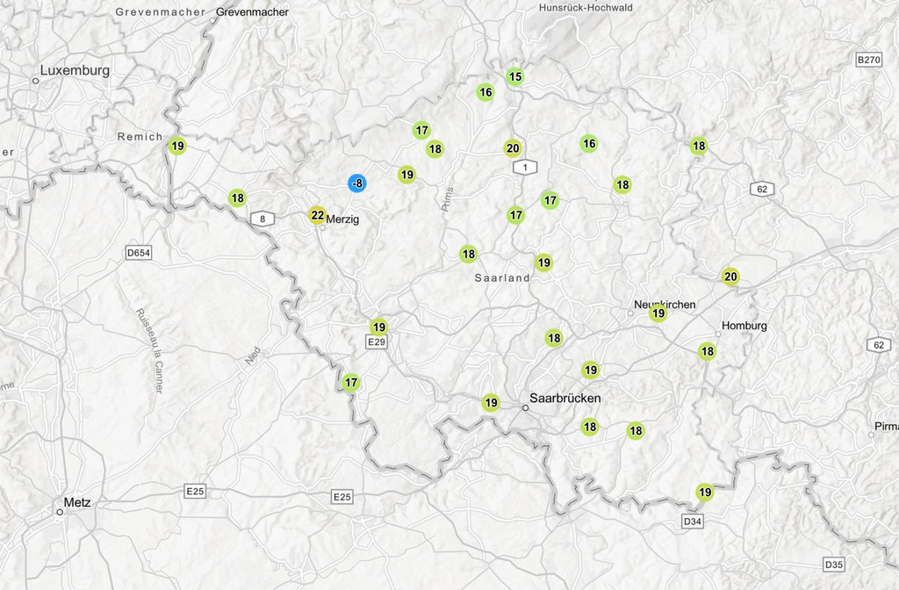
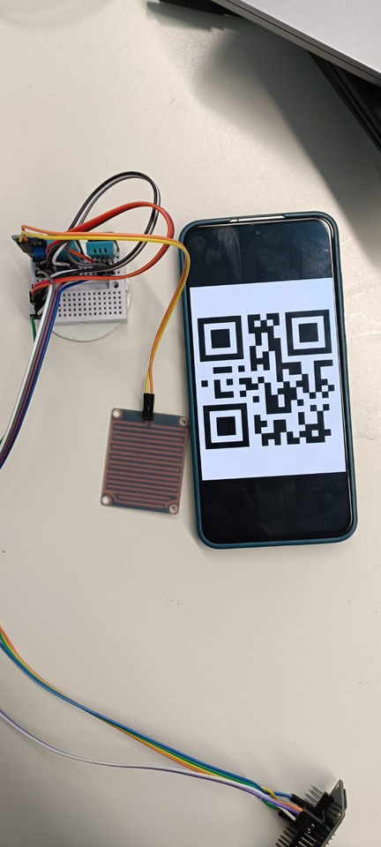
PROBLEM
  Farms, insurers, and corporates need precise local weather data.
  Many private stations stay disconnected and unused instead of being shared and monetized.
SMART FARMING HACKATHON-2025
01

Slide 3
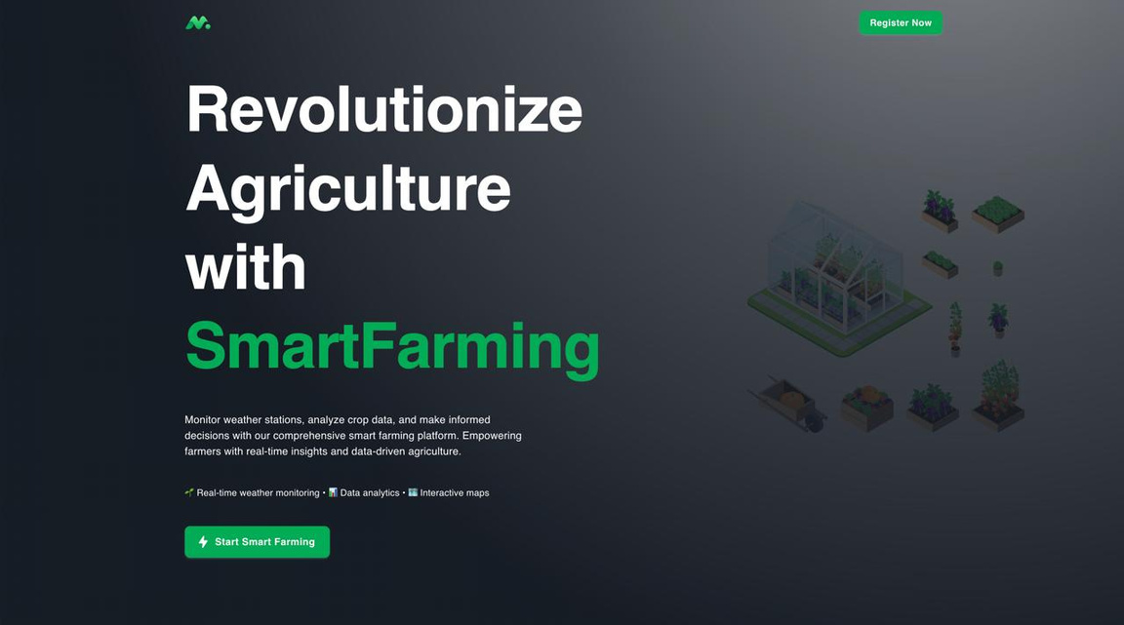
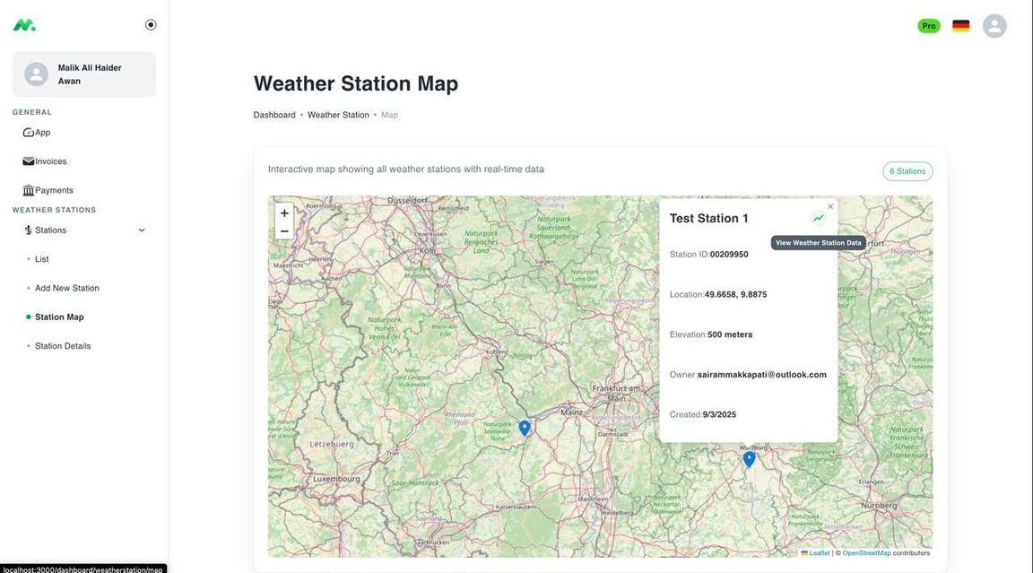
SOLUTION
  Farmers/ organization who maintain weather stations can monetize by sharing hyper-local data.
  Companies gain access to precise, region-specific weather insights for better planning, modeling, and risk management.
SMART FARMING HACKATHON-2025
02

Slide 4
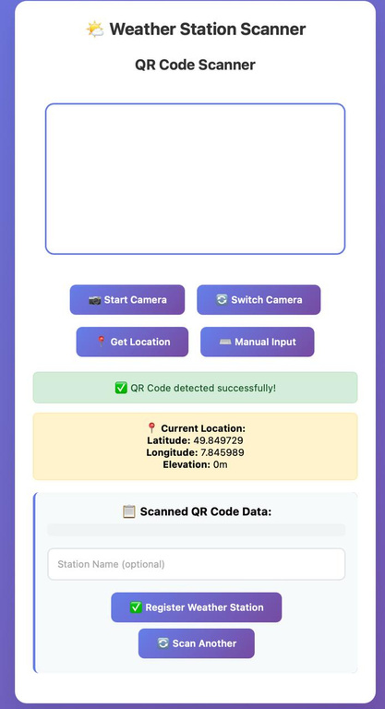
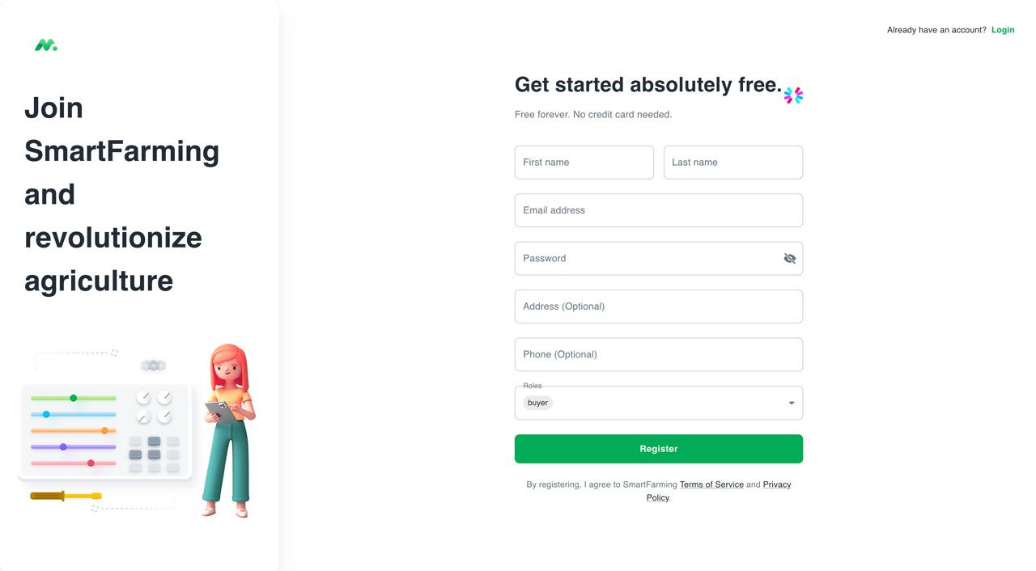
HOW IT WORKS
  Our platform bridges the gap between sellers and buyers of weather station data.
  It also helps the farmers to easily register their private weather stations by scanning a QR-code.
SMART FARMING HACKATHON-2025
03

Slide 5
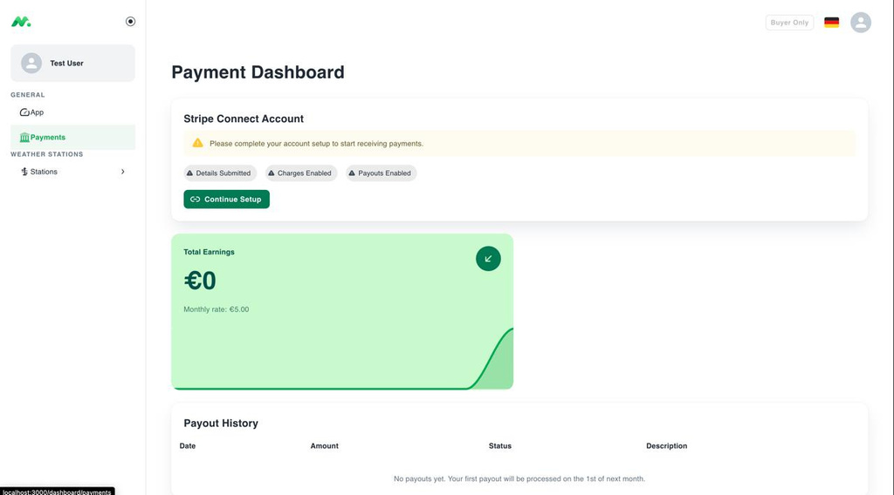
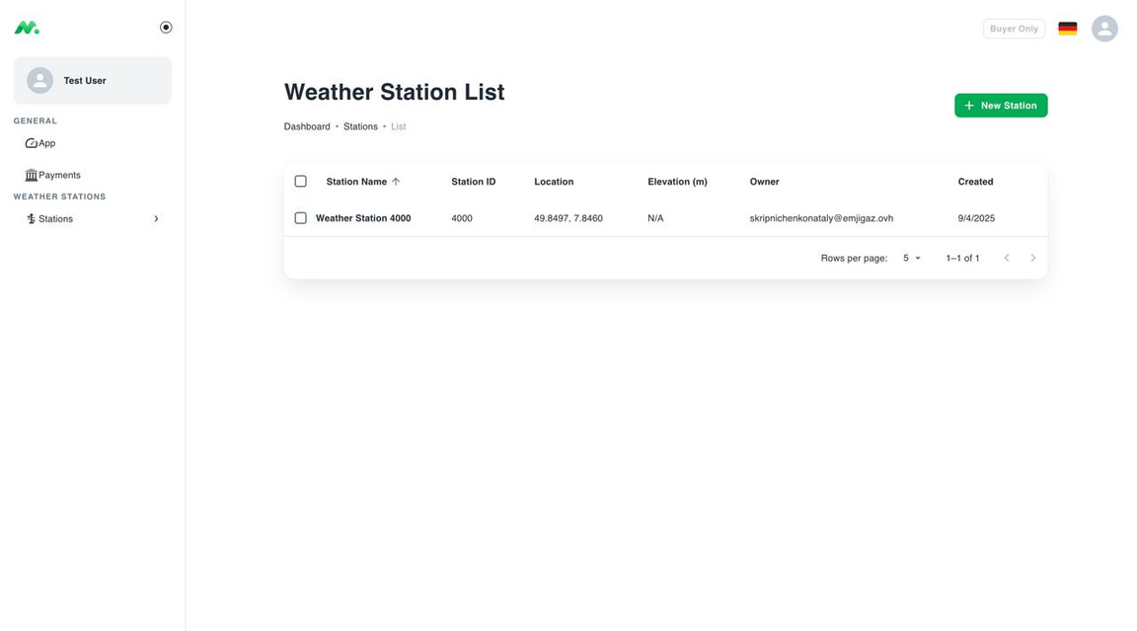
PLATFORM FEATURES (SELLER)
  Will receive micropayments for sharing the data via Stripe.
SMART FARMING HACKATHON-2025
04

Slide 6
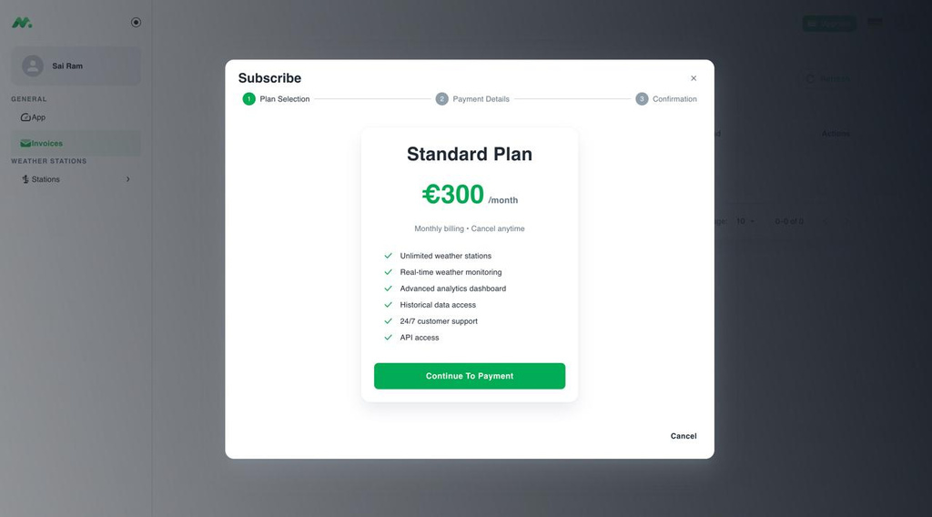
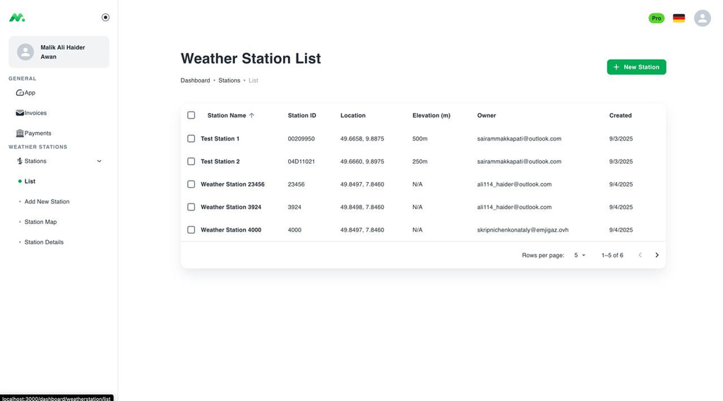
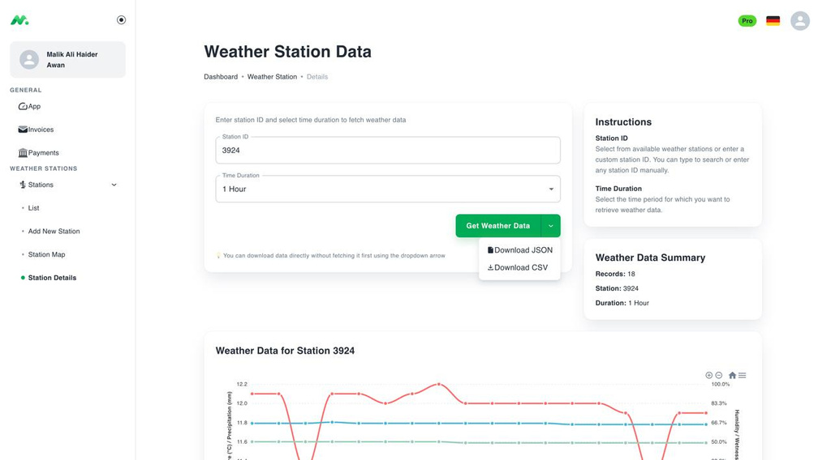
PLATFORM FEATURES (BUYER)
  More precise data for better analysis
SMART FARMING HACKATHON-2025
05

Slide 7
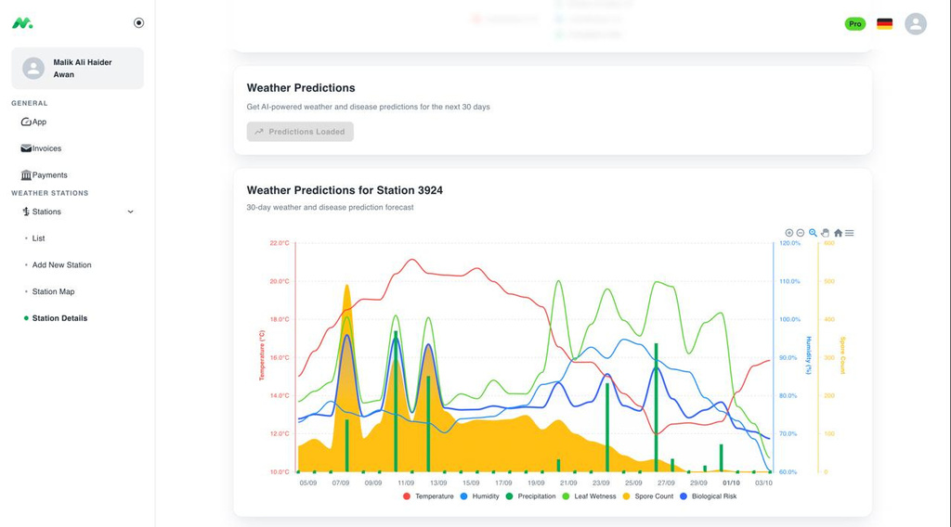
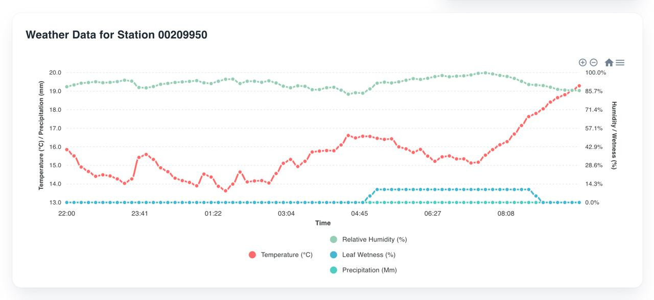
IMPACT
  Maintained data is used for better forecasting
SMART FARMING HACKATHON-2025
06

Slide 8
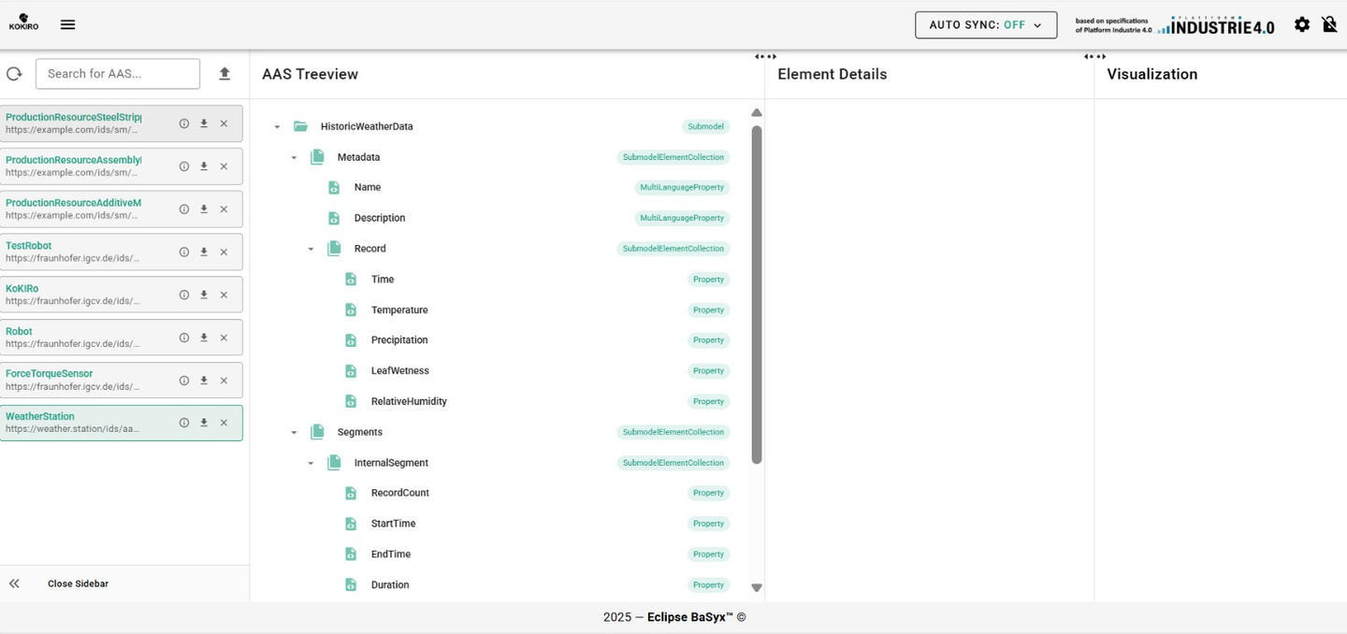
FUTURE SCOPE
  Industry 4.0 standard IoT communication can be integrated into the platform.
  Platform can be extended by adding regulation data.
  Interoperability across smart farming is enabled by introducing digital twin.
SMART FARMING HACKATHON-2025
07

Slide 9
Thank you!

